Slide 1
February 8, 2021

Slide 2
Objectives
the importance of digital sovereignty, its borders and technology used to collect information and also how to protect it
we will discuss the availability of large pools of data, and infrastructure for using and exchanging data
importance of appropriate governance rules and regulation
visibility into the clouds they use
Questions
What is Data Sovereignty?
How does the World handle the notion of data protection and what policies other countries have?
What areas should have the highest level of investments in R&D and cybersecurity sector adoption in Qatar?
INTRODUCTION

Slide 3
PANELLISTS

Slide 4
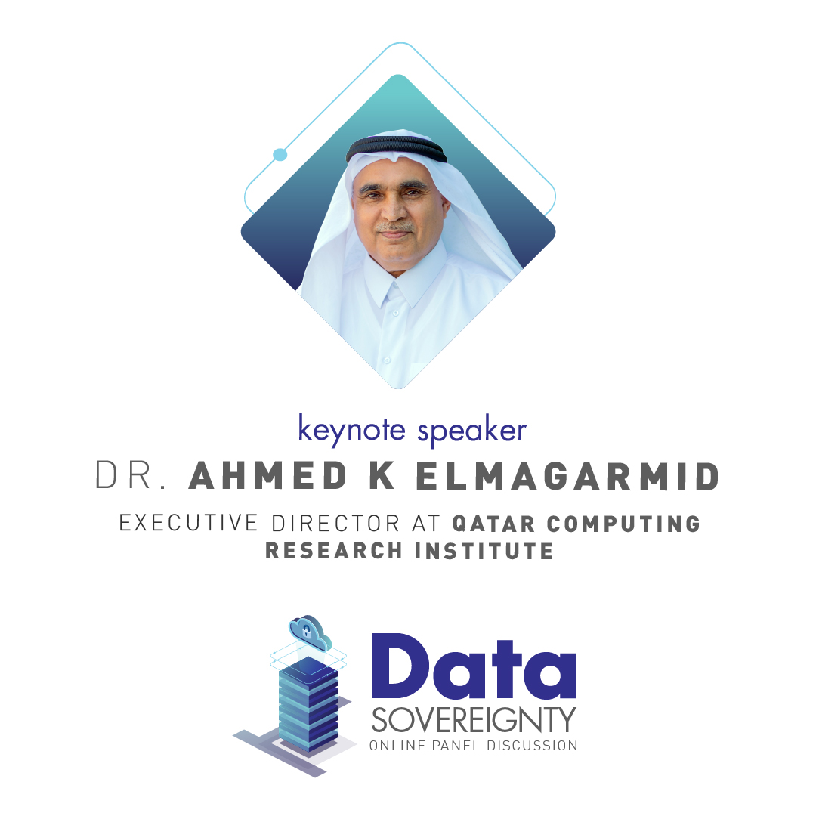
Executive Director at Qatar Computing Research Institute and the founding Executive Director of Qatar Computing Research Institute (QCRI)
Emeritus Professor of Computer Science at Purdue University (US)
an accomplished and well-published scientist, authoring six books and more than 180 papers
He has also been granted eight patents in the database field from USPTO and the EU patent office and developed several software systems that have since become startups
Dr. Elmagarmid is a recipient of the National Science Foundation Presidential Young Investigator (PYI) Award from President Reagan and is an IEEE, ACM, and AAAS Fellow.
Keynote Speaker

Slide 5
Digital Sovereignty: National Cyber Security Research Lab (NCSRL)
Ahmed Elmagarmid

Slide 6
Digital Sovereignty
Sovereignty is a political concept
Nation states can make their own laws to manage their affairs
Digital (or Data) Sovereignty
The data of the people and organizations within a nation, are subject to that nation’s laws (i.e., the legal protections and punishments).
Notes:
The flow is as follows:
1- Define digital sovereignty
2- Challenges in digital sovereignty
3- QCRI’s role is establishing the countries digital sovereignty:
NCSRL: building capacity and local capabilities + developing novel in-house technologies to safeguard digital sovereignty + consultation services to help local stakeholders
Also work globally to achieve digital sovereignty for individuals on public platforms such as social media
4- Migrating data to public cloud becomes an unavoidable necessity (Qatar migrates to Azure): in this case adhere to best practices to protect digital sovereignty
5- (if time allows) Attacks on digital sovereignty

Slide 7
Digital Sovereignty
Most nation states have data related laws to strengthen their nation's ability to act independently in the digital world and provide:
Protective mechanisms and offensive tools to foster digital innovations
Individuals’ control and ownership of presence on the digital world
Investment in the development of in-house solutions/technologies
Building local capabilities/expertise

Slide 8
Challenges in Digital Sovereignty
In-house technology for highly sensitive mission-critical systems
Enterprise security, nation-wide cyber security intelligence
Data security and control while migrating to cloud
Have users better control their own data
Notes:
Because highly sensitive data must be kept locally and only processed or accessed by trusted parties.

Slide 9
National Cyber Security Research Lab
(NCSRL)
Supports the R&D mission of NCIS
Directly linked with NCIS
Provides advisory role to NCIS
Continuous threat assessment
Identifying and predicting future threats
Disseminating intelligence
National capacity building
Training and awareness campaigns

Slide 10
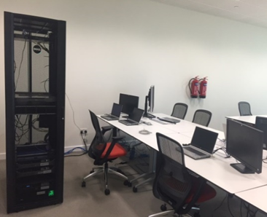
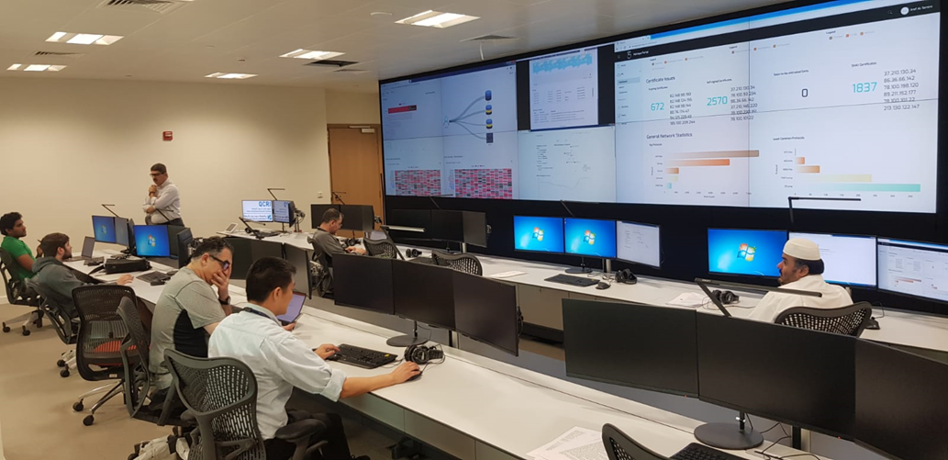
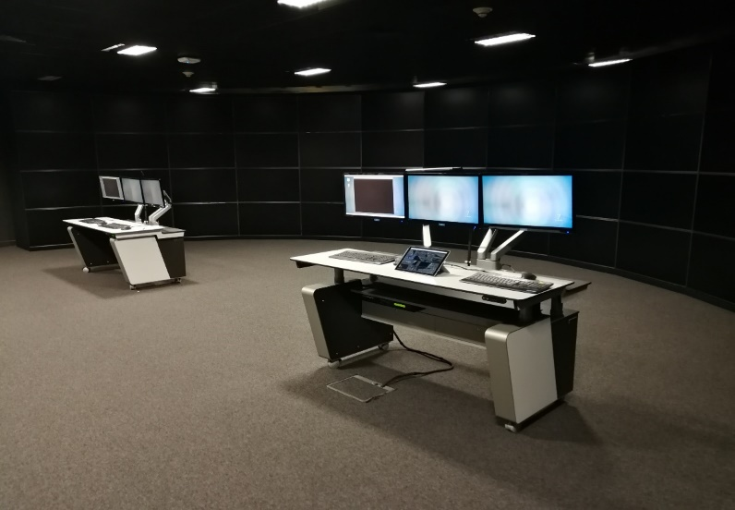
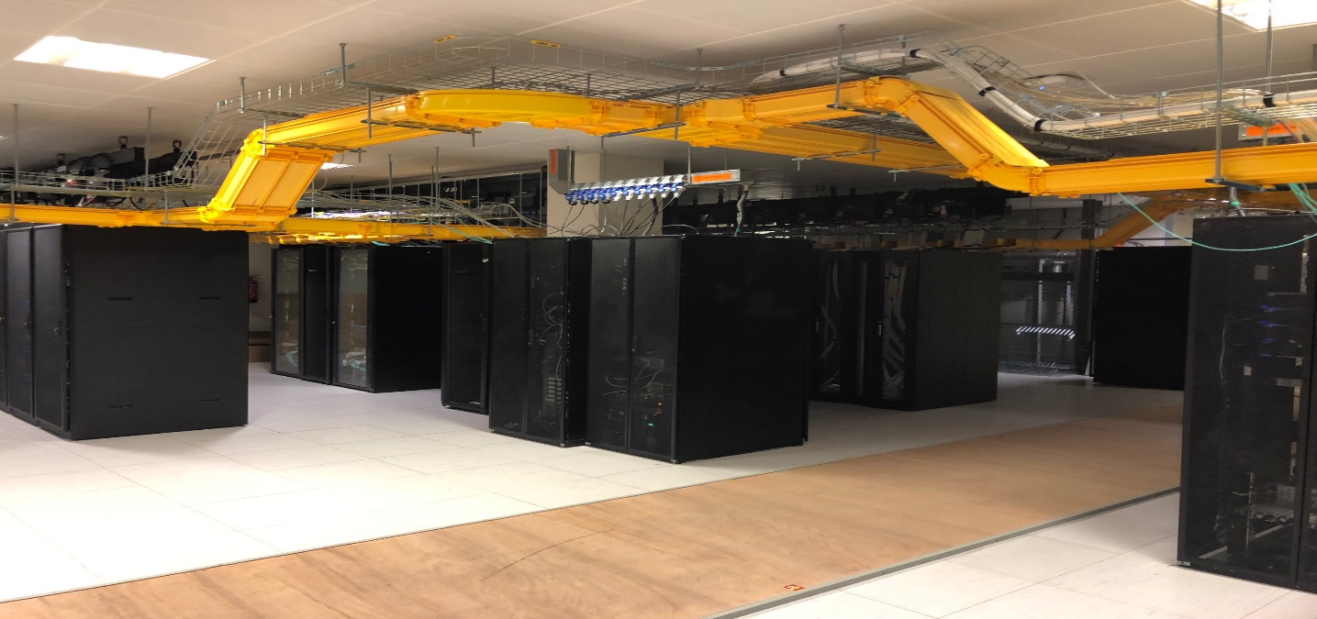
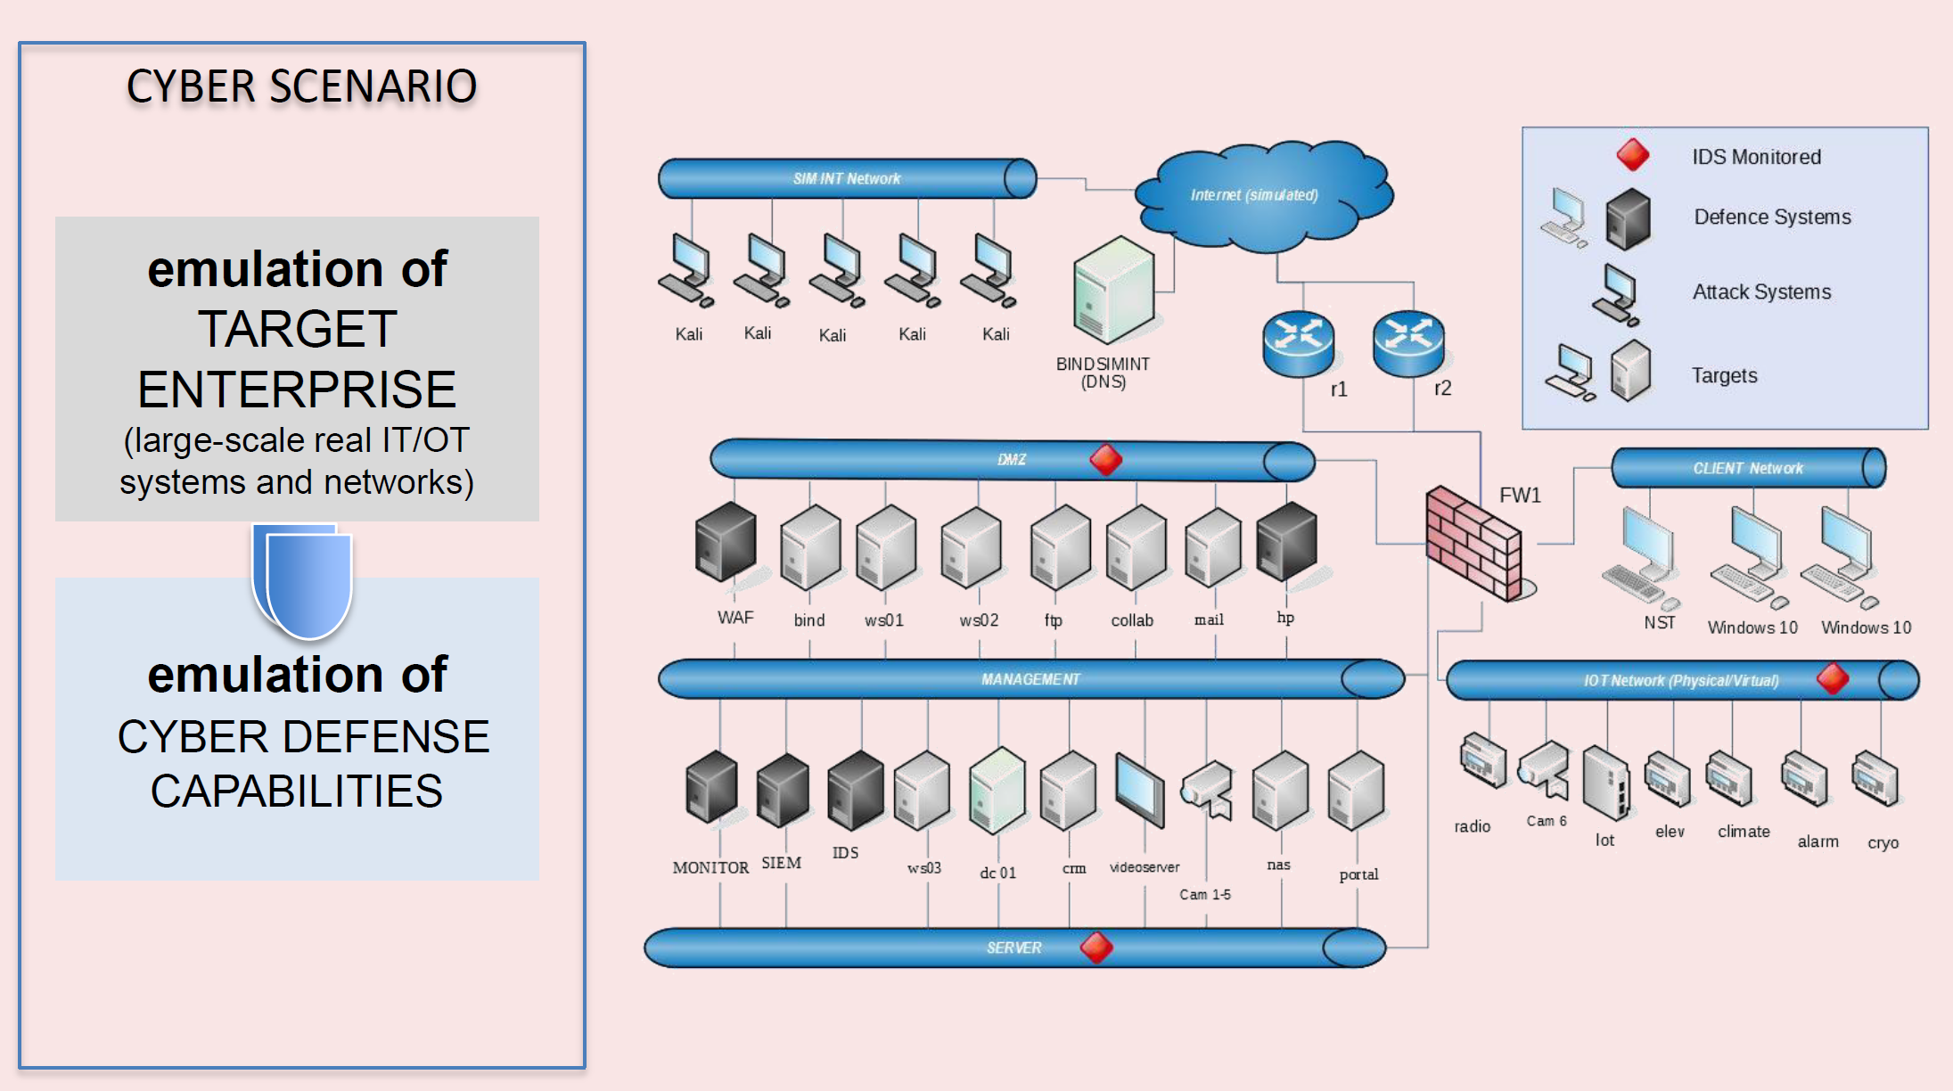
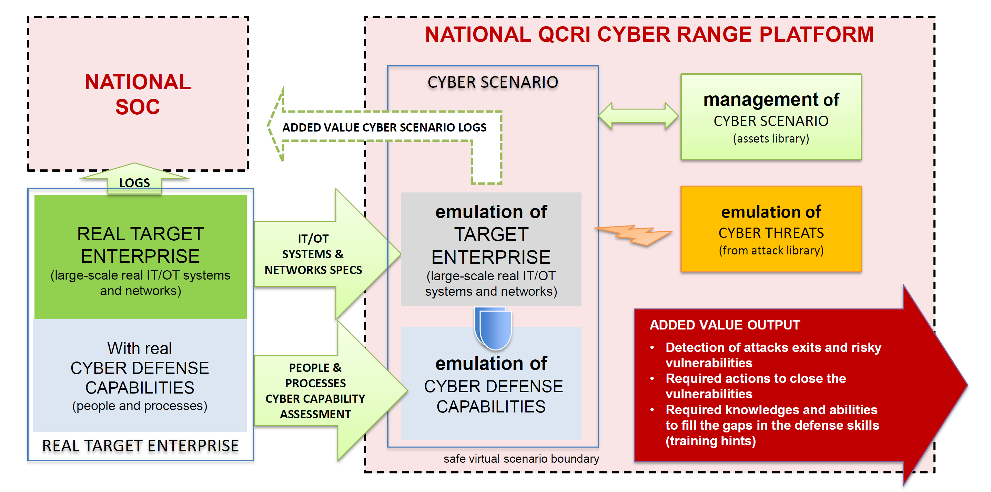
NCSRL Infrastructure
Secure Data Lab
Security Operations Center (SOC)
2d and 3d visualization rooms
2d and 3d visualization rooms
Cyber Infrastructure
Cyber Range

Slide 11
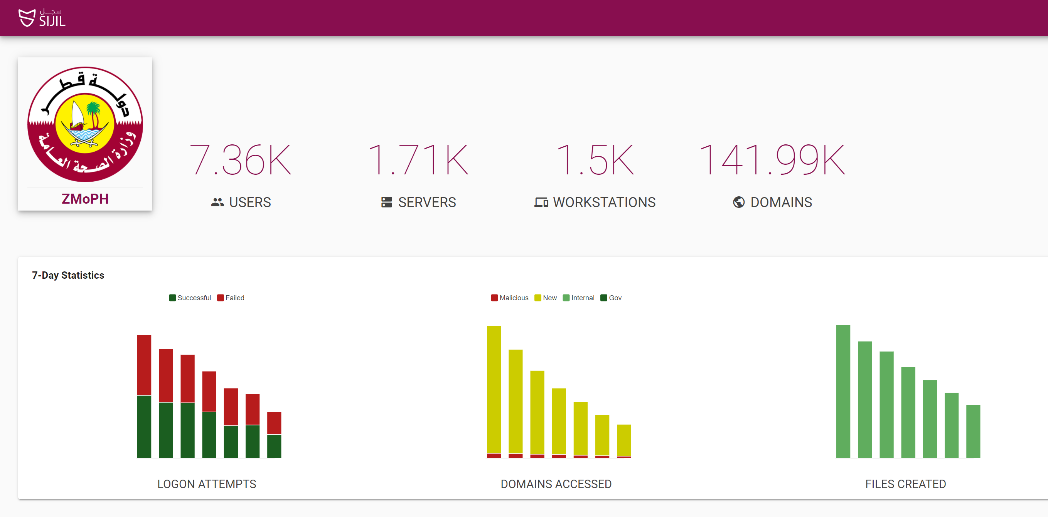
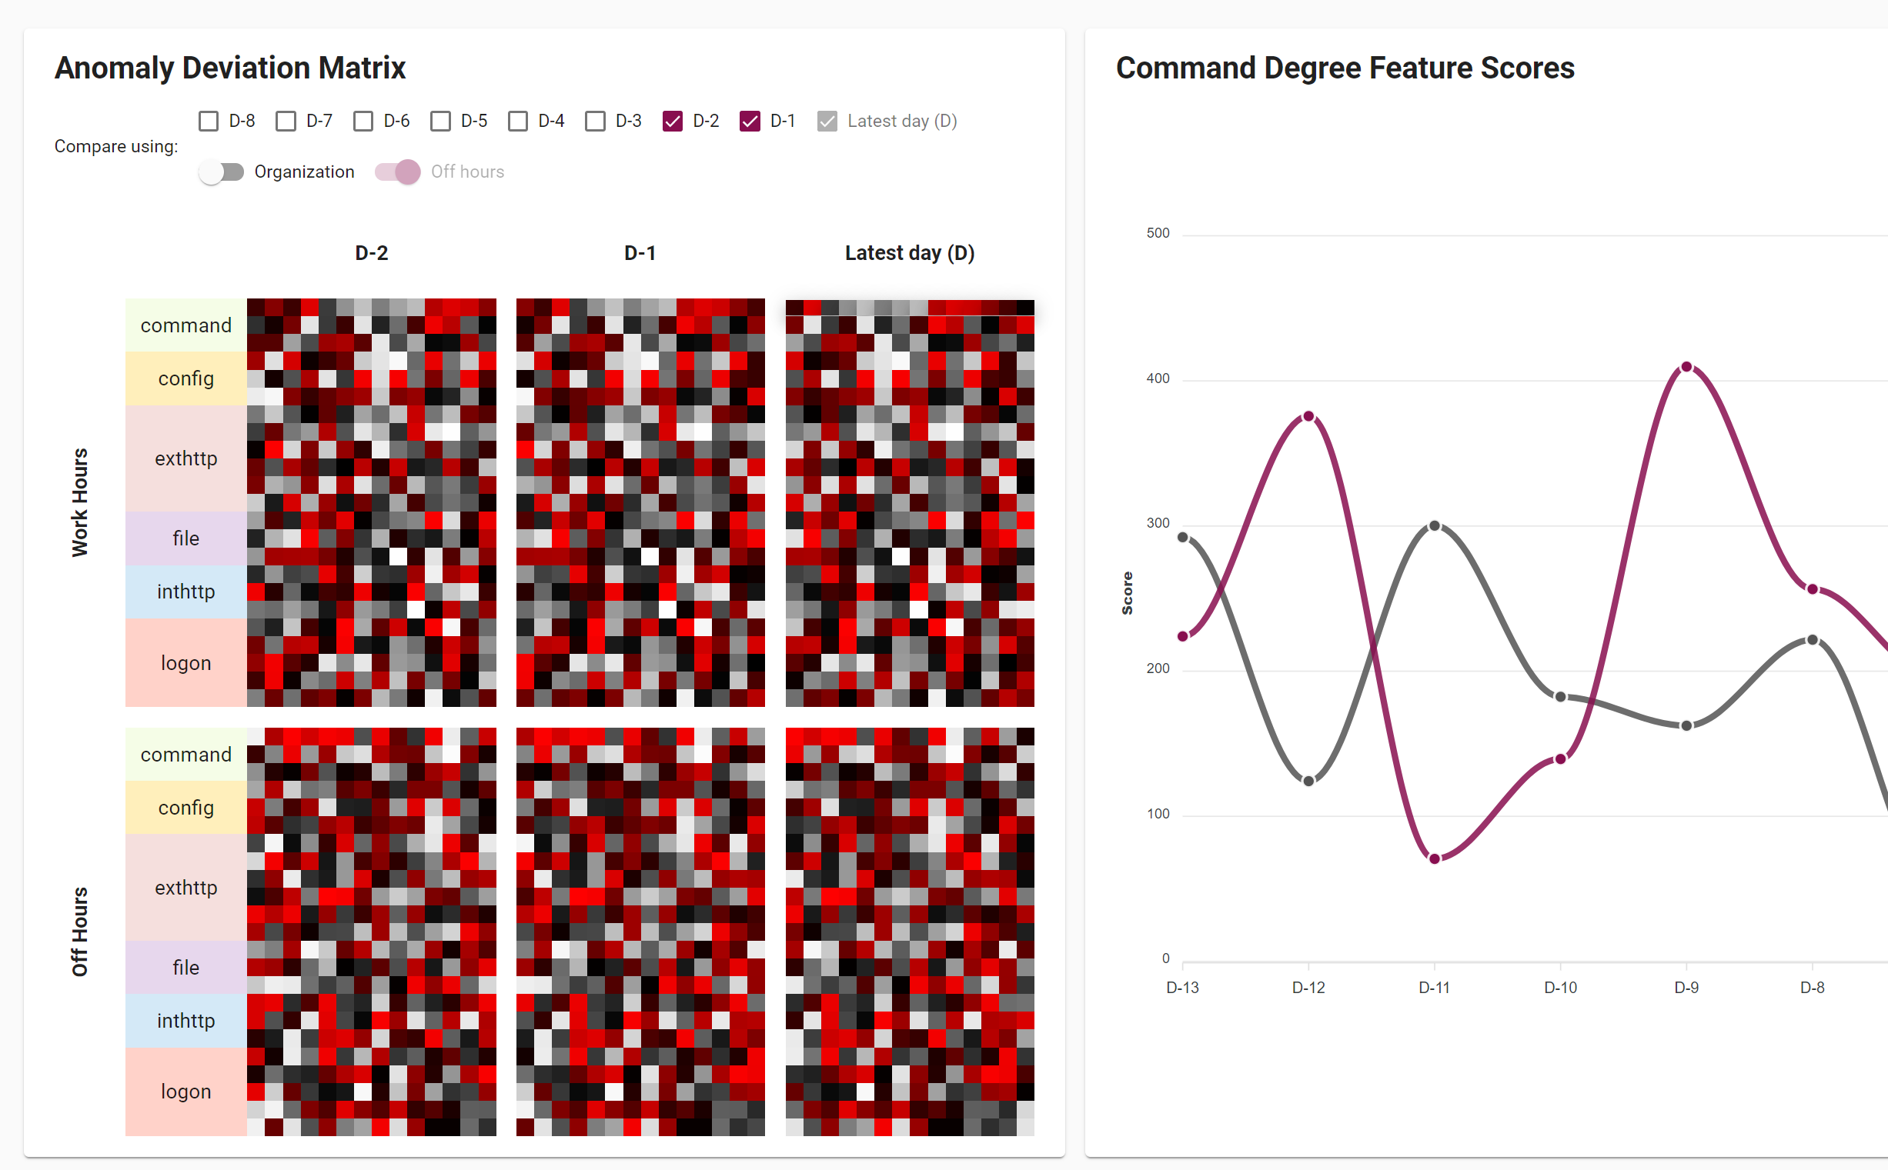
NCSRL Enterprise Security
Early detection and prediction of enterprise threats like malicious domains
Closely work with MOI to identify problems and validate solutions
Key deliverables
Daily intelligence list of suspicious domains/URLs/IPs
Compromised assets (e.g., infected with malware, bots, VPN, ToR, fetc.)
Suspicious user activities (SIJIL)
Content-agnostic detection of unwanted emails
Training workshops (Cyber Range)

Slide 12
NCSRL Cyber Security Intelligence
Four patents about malicious domain detection licensed to Bfore.net
Early detection and prediction of Malicious domains/URLs (MADA)(COVID-19)
Malicious domain classification for optimal takedown strategies
Early detection of brand squatting domains
Other selected QCRI technologies
Nationwide scanning of public interfacing services (Hemaya-IP)
Cryptocurrency e-crime analytics (TOSHI)
Media forensics

Slide 13
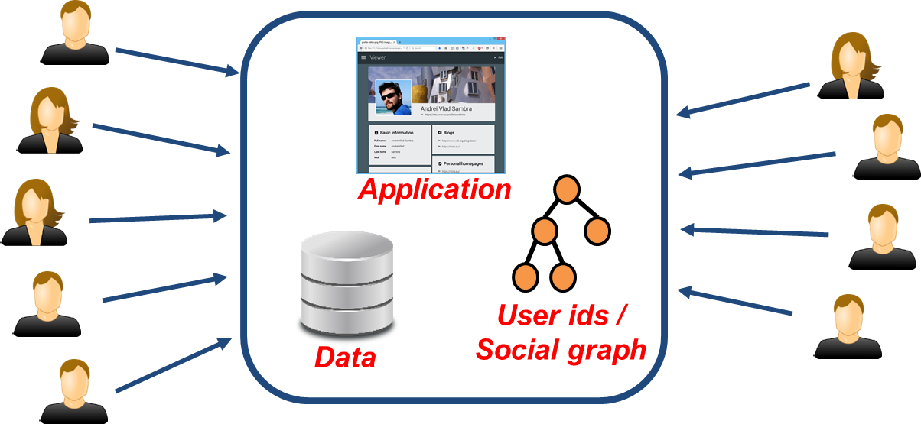
Decentralized Social Media
Social Media is highly centralized (data, application, and user ids all in one place)
Lock in, no interoperability, no control of data
Decentralization -> Social Media as Protocols and service providers
Example: email – SMTP/IMAP protocols and multiple service providers

Slide 14
Decentralized Social Media
QCRI worked on developing a decentralized social media platform called Solid (Social Linked Data) with Tim Berners Lee at MIT
Twitter launched BlueSky initiative for decentralized social media¹
First review paper from BlueSky provided an overview of SoLiD as one of the examples for good products for decentralized social media²
https://twitter.com/jack/status/1204766078468911106?s=20
https://matrix.org/_matrix/media/r0/download/twitter.modular.im/981b258141aa0b197804127cd2f7d298757bad20

Slide 15
Digital Sovereignty & Clouds:
Best Practices
Ensure multi-tenant protection
Cold storage encryption
Efficient privacy-preserving data processing,
Search over encrypted data
Federated learning
Leverage external expertise while enabling local technologies

Slide 16
State-sponsored Cyberattacks
Digital Sovereignty is often under attack by other nations (~600 recorded state-sponsored attacks on govt data/systems in the last decade, 1+/week)¹
No international law or accord to regulate the use of cyberwarfare and provide geo-cyber-stability i.e. Geneva Convention equivalent for cyberwarfare.
No mechanisms to take a legal action
Hence the frequency of such cyberattacks (and counterattacks) keeps increasing
Attribution: Defining “sufficient degree of certainty” to attribute an attack to source-country is an unresolved legal (multi-lateral agreement based) issue
1. https://csis-website-prod.s3.amazonaws.com/s3fs-public/201218_Significant_Cyber_Events.pdf

Slide 17
Thank You!

Slide 18
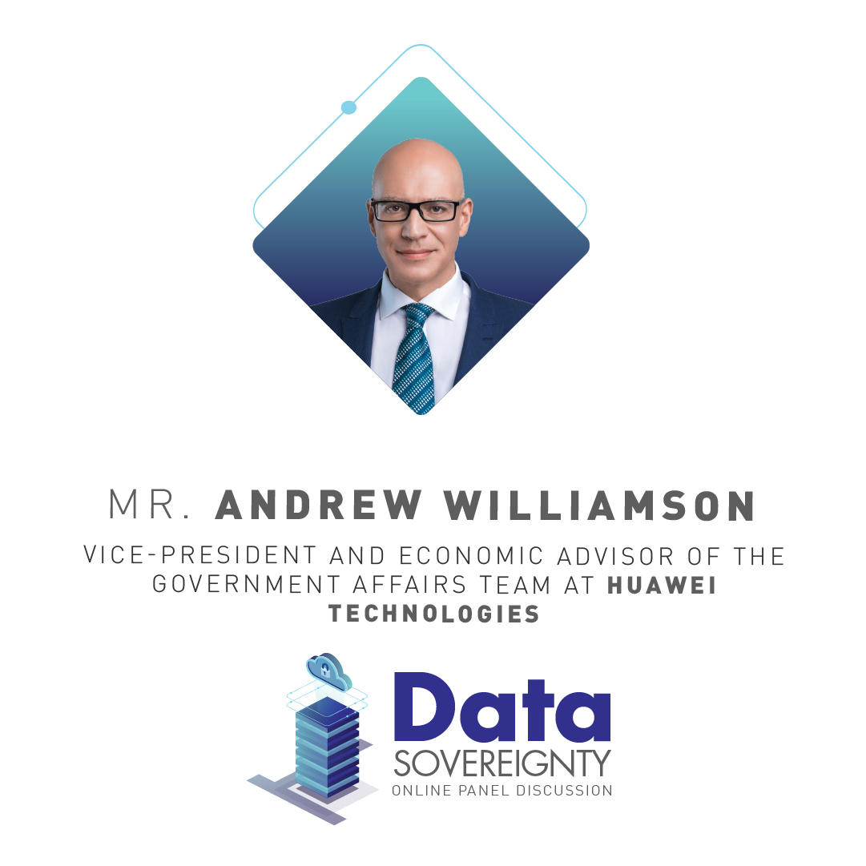
The vice-president and economic advisor of the government affairs teams at Huawei Technologies
Andrew is a key aide on global macroeconomic, political, and industry trends. His research also involves the contribution ICT makes to economic growth and society.
Andrew was Chief Economist at Dun & Bradstreet and Global Leader of its Country Risk department
He worked subsequently at the Grantham Research Institute on Climate Change and the Environment, specializing in research on the opportunities and risks posed by climate change on the financial sector
He began his career in the British Diplomatic Service.
Panellist

Slide 19
European perspectives on digital sovereignty
February 2021

Slide 20
1
What is ‘digital sovereignty’?
Why has ‘digital sovereignty’ become a hot topic?
What is being proposed to support ‘digital sovereignty’?
2
3

Slide 21
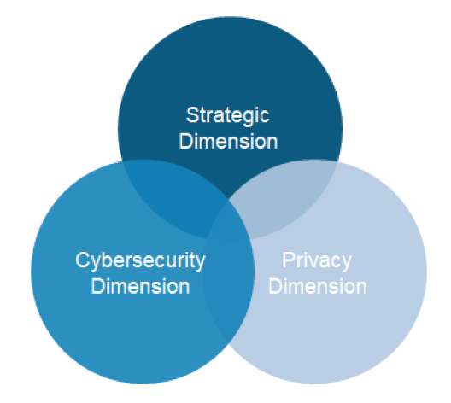
The three dimensions of digital sovereignty
Strategic
Reflecting a recent pivot and perception of the digital geopolitical landscape
Losing the future: The public debate, especially in Europe has taken a turn to emphasise the strategic dimension of the need to catch-up on the leading digital nations and create greater autonomy and fair competition for European stakeholders.
Digital taxation: One commonly voiced grievance is the low – albeit legal – rates of tax paid by global internet giants in Europe. This they believe has further contributed to a feeling of sovereign powerlessness and energized actions to confront it.
Privacy
The right to privacy and data as a national resource
As regards the individual citizen, they point to the requirement that the right to privacy and self-determination over what happens with personal (digital) data must be safeguarded.
As regards the collective level, the quotes allude to the necessity of control over data and information in the digital space, the capacity to reap the economic benefits of that data as well as to participate in world-leading R&D.
Cybersecurity
Cybersecurity was the earliest to emerge as a primary concern of policymakers
1970s: From CREEPER to Reaper. Computer scientists highlight the security vulnerabilities in the ARPANET – precursor to the internet.
1980s: Birth of the internet witnesses state actors involvement.
2010s: This decade experiences the major publicized security breeches including Stuxnet Worm 2010; Snowden & The NSA, 2013; Yahoo 2013-2014; WannaCry 2017.
The three identified dimensions can be traced along a multi-decade long public debate around digitalization
Source: WIK Consult, December 2020. Digital Sovereignty in Europe – a First Benchmark.

Slide 22
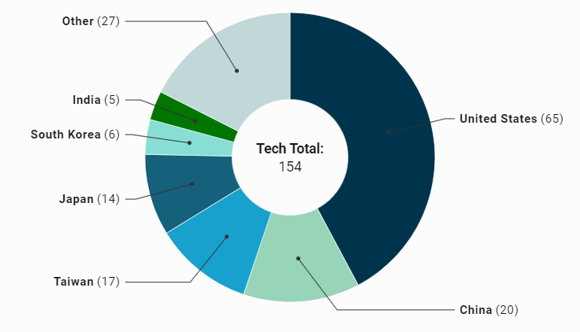
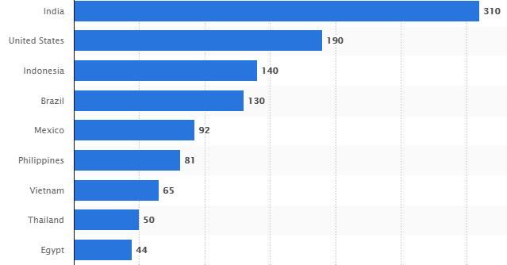
Why do national governments feel that their digital sovereignty is threatened?
Figure 1. Global distribution of world’s largest technology companies
Based on analysis from the Center for European Policy Studies (CEPS) 92% of the Western world’s data are stored in the United States. Only 4% are currently stored in Europe.
Just one American company – Amazon Web Services (AWS) – is estimated to hold one-third of the global market for external servers hosting corporate data. Microsoft and Google are not far behind, with 16% and 7.8% respectively.
Apple alone has a market capitalisation equal to Germany’s top 30 industrial companies in its DAX index .
Ten of Facebooks 15 global data centres are based in North America. Only four are in Europe and only one is in Asia – and that’s in Singapore.
Figure 2. Top markets for Facebook users, January 2021 (millions)
Source: Forbes. May 15 2019.
The Cloud Act: March 2018
First, the Act authorizes the United States to enter into executive agreements with other countries that meet certain criteria.
Second, the CLOUD Act makes explicit in U.S. law the long-established U.S. and international principle that a company subject to a country’s jurisdiction can be required to produce data the company controls, regardless of where it is stored at any point in time.
Source: Statista.com accessed February 4 2020.

Slide 23
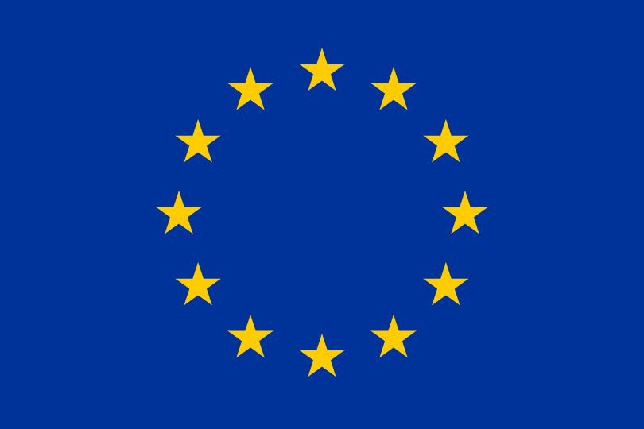
Europe leads the charge on digital sovereignty initiatives
Over the past five years, the European Union has been at the vanguard of digital regulation, enforcing digital taxes, raising privacy standards, and levying landmark antitrust fines. It is considered by many to be a regulatory superpower. A substantial share of the €750 billion recovery fund, announced during the Covid-19 crisis, is earmarked for fostering digital economy in the EU.
Direct investment and support for technological catch-up
DSA and DMA
GAIA-X
High Performance Computing (HPC). Upgrade Europe’s scientific capabilities and industrial competitiveness: converging HPC, Big Data and Cloud Computing technologies; building a competitive European HPC ecosystem. Budget of €2.7 billion (29% of total budget).
The European AI strategy. and the coordinated plan put forward trust and transparency as a prerequisite to ensure a human-centric approach to AI. Funding calls also for a mix of public and private investment (€20bn a year after 2020) and €1bn a year from the EU’s Digital Europe program.
Advanced digital skills. 2021-2027 Digital skills budget of €700m (8.5% of total budget).
E-Government. Digitalisation of public services and their EU wide interoperability. 2021-2027 Deployment budget of €1.3bn (16% of total budget).
Proposal: The aim is to realize the autonomy of EU industry and information. Solve 3 main problems.
Illegal content, goods and services.
Dissemination of false information and freedom of expression.
Users’ rights to choose access to information: transparent algorithms and depersonalised recommendations.
Take asymmetric measures targeting “very large platforms”: enhance obligations, supervision and enforcement (in proportion to their compliance capabilities).
Considering that competition issues are different from issues facing consumers, a new Digital Market Act (DMA) is also being proposed.
Its aim is to be a new competition tool, an ex-ante regulatory mechanism that solves competition issues.
France and Germany are supporting an independent European data infrastructure GAIA-X. Also dubbed “AI-Airbus”. The declared aim is to establish a common data infrastructure based on European values.
A federated technical infrastructure, consisting of components and services that make it possible to access data and to store, exchange and use it according to predefined rules.
the potential dependency on non-EU and in particular US providers of cloud storage
The potential infringement of data protection when data is stored with US-based providers of cloud storage due to the US Cloud Act. National and European cloud services as well as the data embassy concept (which can be seen as an extension of cloud services) can be considered as European alternatives.
Co-sponsored, supported by Siemens, SAP, Deutsche Telekom and Deutsche Bank.
Source: European Commission; German Government 2019-2021

Slide 24
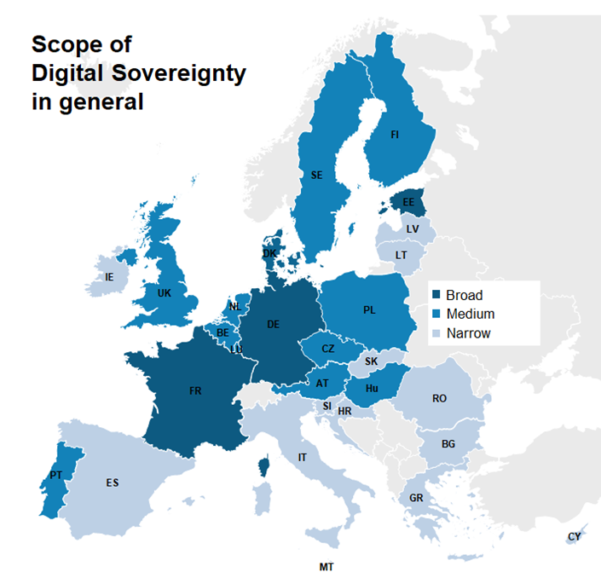
Nonetheless, far from uniform or coordinated approach across Europe
Digital sovereignty does not mean autarky
According to WIK, the EU as well as most of the countries analysed appear to be keen in underscoring that neither digital sovereignty nor strategic autonomy push for autarky or protectionism.
Rather, digital sovereignty is about striking the balance between achieving its own autonomy while still maintaining a diversified vendor portfolio and international trade relations, which are so important for many economies in the EU.
Strategic sovereignty has only been advocated by the few, not the many
The scope of digital sovereignty in the individual Member States differs greatly.
In about half of European countries, there is a rather narrow interpretation of digital sovereignty prevails (coloured light blue). This means that in these states digital sovereignty does not include any components or aspects beyond cybersecurity measures.
Digital sovereignty strategy only exists at the EU-level, Germany, France, Denmark, Estonia.
Data “embassies” overseas – Estonia and Luxembourg lead the way
Estonia – a leader in E-Government – has a government cloud which is physically hosted by (military grade secured) servers outside its borders, in this case, in Luxembourg.
This is done to secure Estonia’s sensitive databases from natural disasters, but also from cyber, terrorist or military attacks.
Source: WIK Consult, December 2020. Digital Sovereignty in Europe – a First Benchmark.

Slide 25
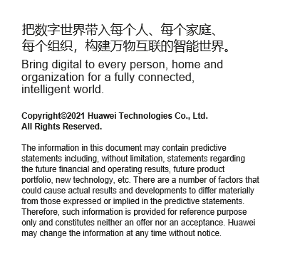

Slide 26
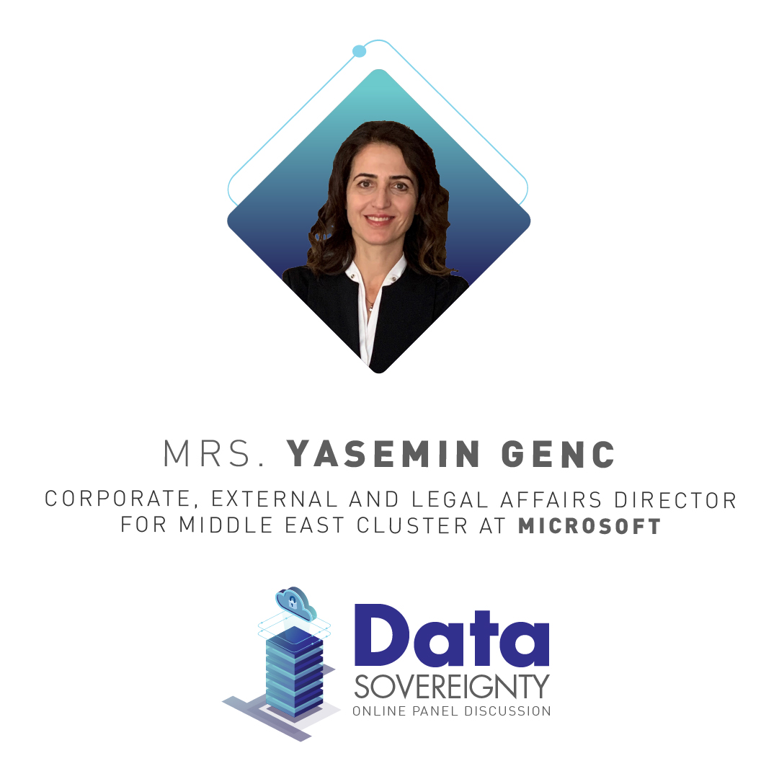
External and Legal Affairs (CELA) Director for Middle East Cluster at Microsoft covering Qatar, Kuwait, Oman, Bahrain, and Egypt
Yasemin was also MEA CELA Commercial Attorney Lead between 2016 and 2019 and CELA Director for Turkey between 2008 and 2016
She worked in various law firms in Turkey, including her own practice between 1998 and 2008
She has her law degree from Istanbul University Law School and LL.M. from the London School of Economics and Political Science.
Panellist

Slide 27
Telecom Engineer with more than 27 years of experience in various fields and with more than 19 years of experience in management positions ranging from telecom engineering, marketing, telecom economics, regulation and competition affairs
Abdulla holds a master's degree in Art in IT business from KAIST University in South Korea (2008) and a bachelor's degree in telecom engineering from the University of Essex - United Kingdom (2000)
He has many contributions and has participated in many international conferences. He also has many contributions in this sector, such as encouraging the use of the Arabic language in the digital world.
Panellist

Slide 28
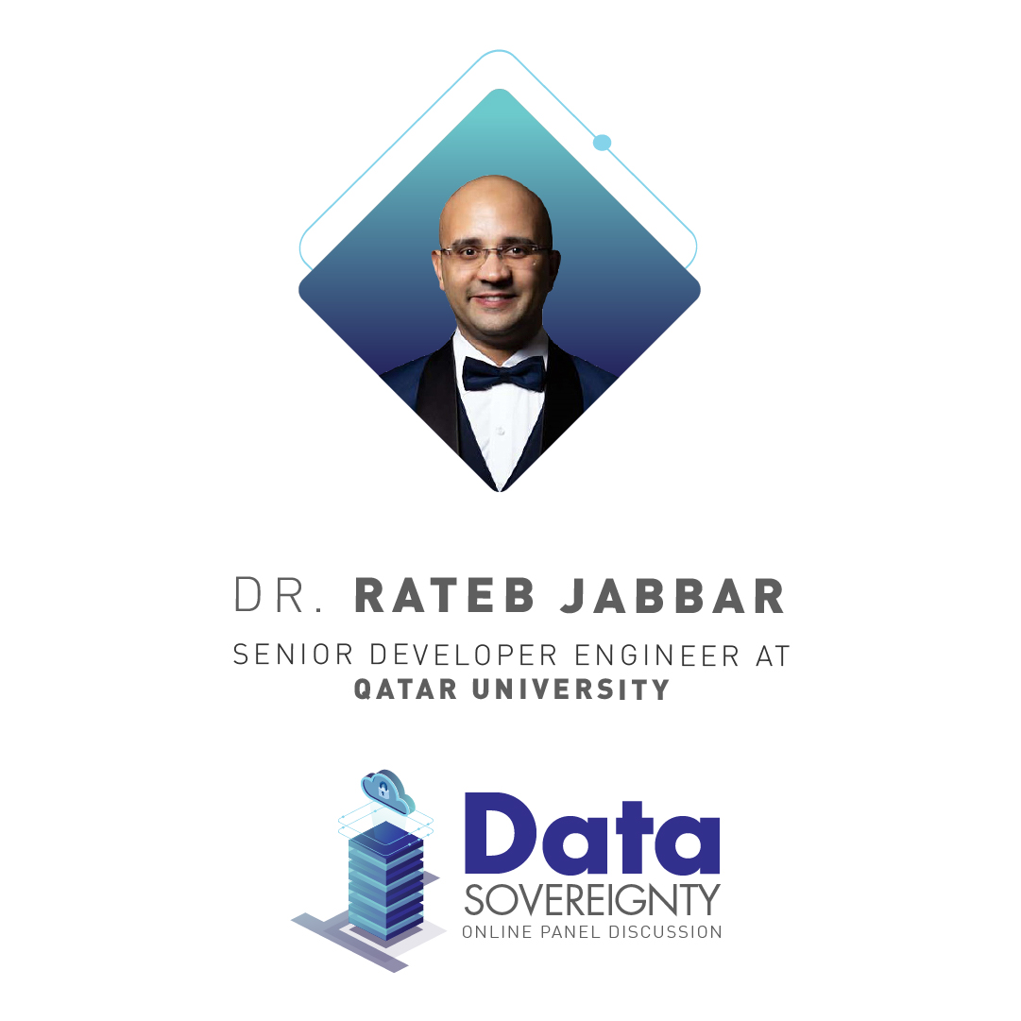
Senior Developer Engineer at the Department of Computer Science and Engineering at Qatar University
Rateb is also a co-founder of the startup Finispia (Fintech), a co-founder of the Startup Lifeye (Ai in Agriculture), and CEO & Co-Founder of IOVision (IT)
he is an accomplished software engineer with 8 years’ experience in the finance and healthcare sector. He is also a Microsoft Certified Professional (MCP) & Microsoft Technology Specialist (MCTS) in Web and Cloud technologies
Mr. Jabbar is a PhD student in Computer Science at Cnam, Paris, France, with a subject focus on - How to use #Blockchain to secure Communication and Payment.
Panellist

Slide 29
Discussion Questions

Slide 30
Question:
Over the past decade the levels of cyber warfare have seen a sharp increase, and their impact is proportionally more damaging in the age of the Internet, Mobility, and cloud adoption at the individual, business, and governments.
What areas should have the highest level of investments in R&D and cybersecurity sector adoption in Qatar?
Dr. Ahmed Elmagarmid

Slide 31
Question:
Digital sovereignty does not necessarily mean autarky or protectionism.
But how best to find the required balance between digital autonomy while maintaining a diversified vendor portfolio?
Mr. Andrew Williamson

Slide 32
Question:
Data classification ownership is shifted to owners by governments and regulators in a global trend.
What impact will this have on cloud adoption especially in the restricted, confidential, and highly sensitive information?
Mrs. Yasemin Genc

Slide 33
Question:
What is the current level of regulatory maturity at global and regional levels regarding transparency in data access either for economic and non-economic purposes?
Mr. Abdulla Jassmi

Slide 34
Question:
In the absence of blockchain adoption in non-currency applications,
what other solutions can ensure that encryption keys and other sensitive technologies are locally controlled?
Dr. Rateb Jabbar

